Slide 1
Equilibrium

Slide 2

In this Smart lesson you will learn to:
Explain the term mechanical equilibrium.
Solve problems involving mechanical equilibrium.
Recall the meaning of the term torque.

Slide 3
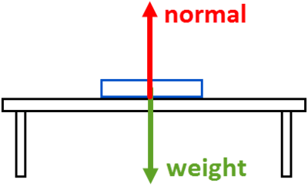
Mechanical equilibrium is a consequence of Newton's First Law.
An object is in equilibrium when it's either stationary or moving at a constant speed.
There are two requirements for mechanical equilibrium to be achieved. First, it must experience no net external force. For instance, all the forces pulling down on an object must be balanced by forces pushing up on it.
A book lying at rest on a table experiences an upward normal (support) force to balance its downward weight force. It is in mechanical equilibrium.

Slide 4

Now you know a lot about forces, but the examples we've seen so far are all forces pushing or pulling things in straight lines.
What happens when you twist or rotate an object instead?
Torque is the name for a turning effect that causes rotation. An object can have a pivot point, usually its centre of mass, around which it can rotate. A torque is produced if the force that is applied to an object is not directed through the pivot point.
Torque is defined as the distance between the pivot and the point where the force is applied, multiplied by the perpendicular component of the force.
In equation form, this is written as τ=Fd. Torque has units of Nm.

Slide 5
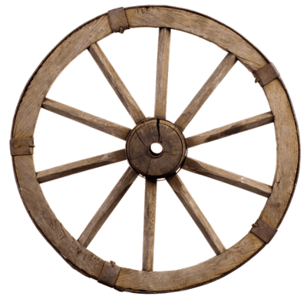
To be in mechanical equilibrium, secondly, there must be no net torque on an object for it to be in equilibrium.
Even when all the external forces are balanced, it's still possible for an object to rotate around its centre of mass. All the clockwise torques must be balanced by all the anti-clockwise torques, so if the object rotates, it does so at a constant angular speed.

Slide 6
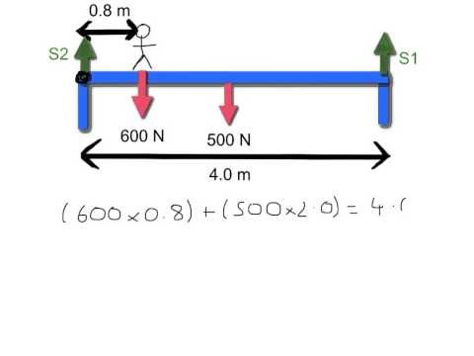

Slide 7

When solving an equilibrium problem, it is important to remember that both the linear forces and the torques must be balanced.
You can break down the linear forces into horizontal and vertical components.
At equilibrium, the upward forces must equal the downward forces.
Similarly, the forces to the left must equal the forces to the right.
Finally, the clockwise turning forces must equal the anticlockwise turning forces.
By using these simple principles, it is possible to calculate any missing values.

